Slide 1
Restaurant Segmentation Analysis
Presentors: Eric Tsai, Xinru Lu, Morris Zhao, Chen Lin
Mentor: Gittu George
June 16th, 2023
Notes:
Briefly introduce the team.

Slide 2

Our Partner
Sitewise Analytics
SaaS company
Specialize in site selection for restaurants, retailers, service providers
Statistical analysis to find drivers of sales performance
Notes:
Introduce our partner.

Slide 3
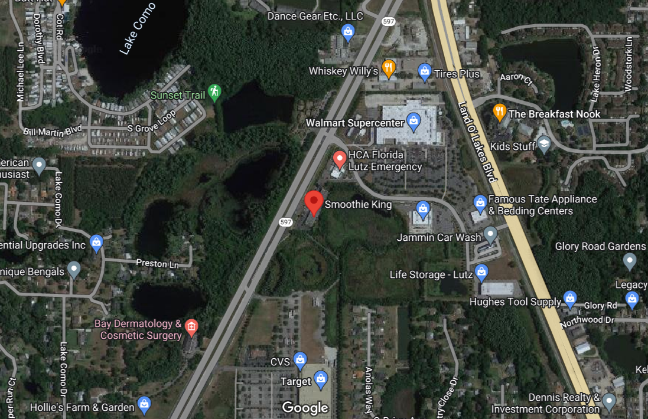
Where are the customers from?
Local residents?
Shopping centers?
Workspace?
Highway Exits?
Hmmmm…
Notes:
Now I’d like to raise a question: based on the google map view, where do you think are most of the customers coming from to this restaurant location?
Raise hands for each option.

Slide 4


General Motivation
I am labeled.
I am not labeled.
🇺🇸
Task 1: Supervised ML Model
Task 2: Unsupervised ML Model
Identify similarities and differences between locations
Predict type of major incoming traffic based on store location
from workplaces, from residential areas, from highway traffic, etc.
Key indicators for each type
E.g. amount of land available for lease, high/low density living area, etc
Notes:
It is hard to predict the major traffic type by looking at the map, and therefore we are here to help out. Let’s start with the general motivation behind this question. Why are we even interested in this?
Turns out as one of the initial steps in the making strategic expansion for a specific restaurant chain, it is very important to first identify similarities and differences between its busy locations. By predicting the type of major incoming traffic, which is highly correlated with sales performance, the chain can make efficient marketing strategies accordingly. The type of driving traffic among different store locations will differ based on the surrounding area, including demographic information such as population density of households, as well as point of interest information such as number of highway exits nearby. To help with such a process, we are seeking to construct a segmentation system based on clustering machine learning methods to group stores with similar traffic drivers.
Although we have a common general motivation, with two different datasets, we have two independent tasks here.
First one is for customer Smoothie King, which comes with a dataset that is labeled, therefore a supervised machine learning model. Second one is for customer Subway, with unlabeled data, therefore an unsupervised machine learning model.

Slide 5

Data
2 datasets from 2 customers: Smoothie King and Subway USA
Demographic Variables
Population of people in different age range
Number of people with income level USD
Point of Interest Variables
Gross leasable area
Number of hospital beds nearby
Public school enrollment count
Store Information
Latitude/longitude
Market size (e.g. large city, small town, etc)
Over one thousand features !
Notes:
(Briefly go over) We have received two separate datasets for 2 customers. Within each dataset, it has demographic, POI variables, and store information. In total, it has over a thousand features for each store location.

Slide 6
Notes:
First I’d like to talk about our work for customer Smoothie King.

Slide 7
Supervised Machine Learning Model
Smoothie King dataset is labelled with true traffic types
Home
Travel
Shopping
Work
Other (a group of niche traffic types such as military base)
Train a supervised ML pipeline to predict these target labels
Identify the most important features for each target class
Acceptance criteria: accuracy of 70%
Notes:
Task here is to first construct a supervised machine learning pipeline to predict the true major traffic types of a Smoothie King store, and most importantly identify the key features for each type based on the model. Since SK dataset is labelled with true traffic types, we have a specific acceptance criteria of a test accuracy score of at least 70%.

Slide 8
Steps of Our Workflow
Step 1: Data preprocess
Step 2: Hyperparameter tuning on different models
Step 3: Model building
Step 4: Feature importance interpretation
Notes:
We will go into the four steps we took in solving the smoothie king task. I will hand over to Eric for the details of each step.

Slide 9
Step 1: Data Preprocess
Mainly feature selection (over 1k features)
For features with raw counts and percentage values
E.g. in a specific trade area, the number of households with 1 person v.s. the percent of households with 1 person
Dropped the raw count features and kept the percentage value features
Remove features that were irrelevant to prediction task
Final dataset: 796 rows with 257 columns (90/10 train/test split)
Notes:
First we need to construct a data preprocessing pipeline to reduce the dimensionalities and filter out non-significant features. One systematic approach we took was for features with both raw count variables and percentage variables, we only kept the percentage value features. Another method we took from manual analysis to
Reason for keeping only percentage value features is that with raw values, a higher raw value may indicate a region’s density as opposed to the region’s demographic. For instance, a high raw value of households with 1 person near a store could just mean that the store is in an urban region, but it could be that the actual percentage of households with 1 person is low. Thus, percentage value features is more useful in the sense that it is more general.
Perform feature selection
Remove raw counts and keep percentage values
E.g. number of households with 1 person vs percent of households with 1 person
Raw value may indicate region’s density, but percentage indicates region’s distribution of population type (more useful)
Remove irrelevant features
E.g. climate, state a store is located
Constant value
796 rows with 257 columns
90/10 train test split

Slide 10

Step 2: Hyperparameter tuning on different models
Tried many different models
LogisticRegression
RandomForestClassifier
LGBMClassifier
XGBoost
RandomizedSearchCV
Multinomial vs OneVsRest
L1/L2 Regularization
Notes:
From the model selection process, we see RFC has the best performance on our data, therefore selected to proceed further.

Slide 11
Step 3: Supervised Machine Learning Solution
Baseline LogisticRegression model (~45% accuracy)
VotingClassifier ensemble model of 3 input models:
RandomForestClassifier
RandomForestClassifier with L1 regularization
RandomForestClassifier with one-vs-rest wrapper and L1 regularization
Each input model achieved around 65% accuracy
VotingClassifier model achieved 70% train and test accuracy
Notes:
Baseline LogisticRegression model with default parameters of 45% accuracy
Final model is VotingClassifier ensemble model -> 3 input models
RF, RF + L1 reg, RF OVR + L1 reg
Each achieved between 65-67% accuracy
VotingClassifier model achieved 70% train/test accuracy
RF models make different mistakes and get different predictions correct -> hard voting increase score

Slide 12
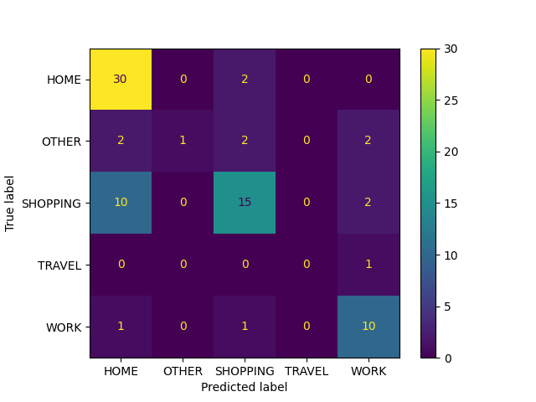
Prediction confusion matrix on test set
Notes:
为啥shopping和home像？——》accuracy低
We see that majority are in diagonal -> 70% accuracy
Big issue when true label is SHOPPING
Model often predicts SHOPPING as HOME

Slide 13
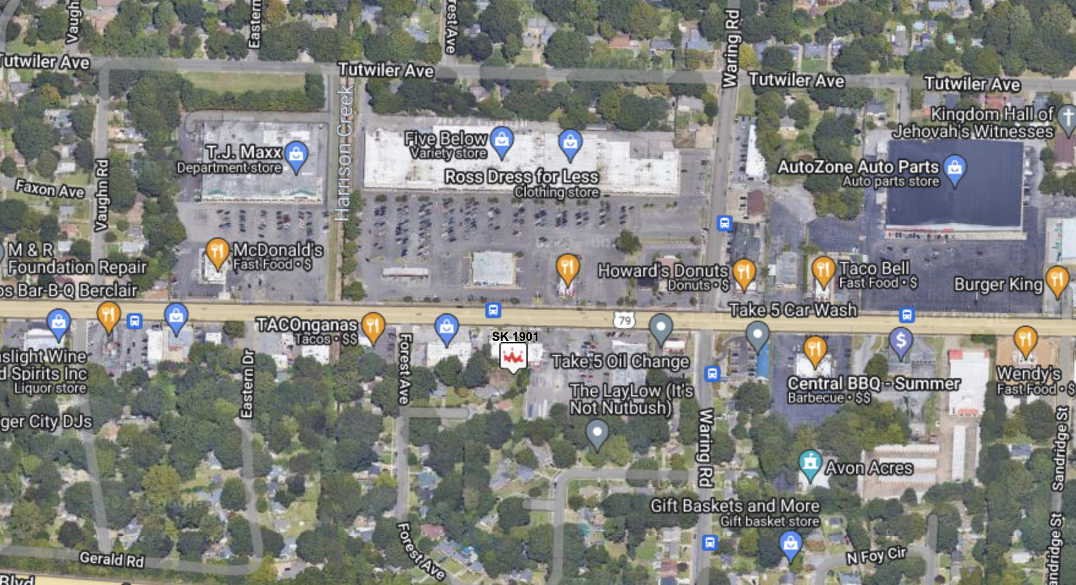
True label: SHOPPING Predicted label: HOME
Notes:
SK 0837 - add SHAP force plot
Area has stores for shopping but also houses
Makes sense -> residential areas often have stores for people to buy daily necessities

Slide 14
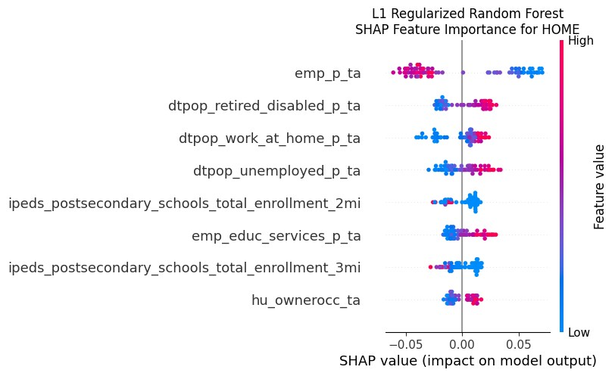
Step 4: Feature Importance using SHAP
Target Category:
HOME
Model:
RandomForest +
L1 Regularization
Employment percentage
Daytime population (retired/disabled person)
Daytime population (work at home)
Daytime population (unemployed)
Postsecondary total enrollment (2mi radius)
Employment (education services)
Postsecondary total enrollment (3mi radius)
Homeowner occupied
Notes:
Interpret feature importance of the model by looking at the individual models going into the VotingClassifier
If individual models have similar important features, then those features are the main driving factors for a prediction of a target category
RF + L1 reg model with target HOME
Most important features that also make sense intuitively:
employment percentage -> lower value has higher SHAP value
Other features such as daytime population of WFH or retired/disabled important

Slide 15
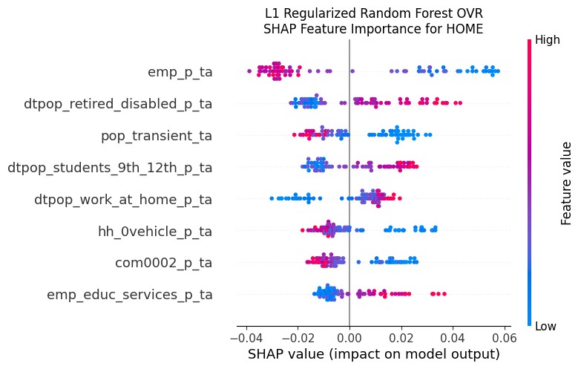
Step 4: Feature Importance using SHAP
Target Category:
HOME
Model:
OVR RandomForest +
L1 Regularization
Employment percentage
Daytime population (retired/disabled person)
Transient population
Daytime population (grade 9-12 students)
Daytime population (work at home)
Household (no vehicle)
Commute (0-2 mi)
Employment (education services)
Notes:
SHAP of RF+OVR+L1 reg
Also see employment percentage -> lower lead to high SHAP value
Also see daytime population of WFH and retired/disabled important
Those are important features for predicting HOME category
We do the same for other categories (WORK, SHOPPING, etc.) to identify different important features

Slide 16
HOME?
SHOPPING?
WORK?
TRAVEL?
True label: HOME Predicted label: HOME
Polling Result
Notes:
SK 0837 - add SHAP force plot
Now we go back to the SK location from before
Might think this location category is SHOPPING, but the true label is HOME
This is why we need to look at features that we cannot observe on a map
why?

Slide 17
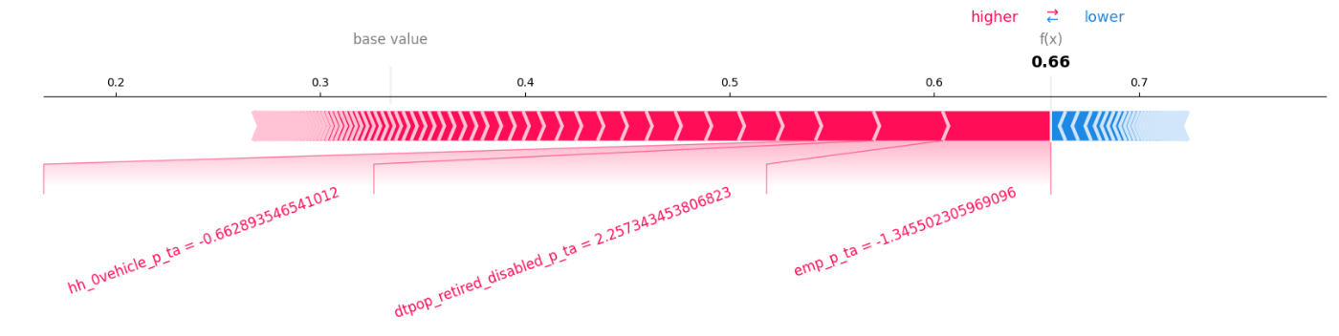
SHAP Force Plot
Model: RandomForestClassifier with OVR and L1 Regularization
emp_p = employment percentage dtpop = daytime population
Notes:
Look at SHAP force plot to see features driving the prediction
See negative scaled value of employment percentage -> low
Positive scaled value of retired/disabled population
(EXPLAIN variable names)

Slide 18
Subway USA
🇺🇸
Notes:
For now, we can leave the Smoothie King task on the side
and switch your attention to another restaurant chain — Subway USA

Slide 19
Unsupervised Machine Learning Model
Subway USA data is not labelled
Train an unsupervised machine learning model to cluster store locations into groups
Interpret the results to determine features that cause each store to be clustered into each group
Notes:
For Subway USA, we were asked to build an unsupervised Machine Learning model.
Because the data provided by the partner is not labelled
which means we do not know if a Subway store can be categorized as HOME, or WORK or SHOPPING,
just like how the Smoothie King stores were categorized.
Therefore we need to build an unsupervised Machine Learning model to cluster those Subway stores into different groups
where they share the most similarities within the group,
potentially those clusters can be categorized as the Smoothie King stores
At the end, we need to determine and interpret what are the driving features to cluster those stores into different categories.

Slide 20
Steps
Step 1: Data preprocess
Step 2: Model Building
Step 3: Label Verification
Step 4: Cluster Interpretation
Notes:
To fulfill this task, we followed these 4 steps.
I will be covering the first 2 steps: Data Preprocess and Model Building
And Morris will cover step 3 and 4 later, which are Label Verification and Cluster Interpretation

Slide 21
Step 1: Data preprocess
Feature selection:
Prior knowledge on important features
Removed irrelevant features similar to the Smoothie King dataset
Feature engineering:
Combine different household sizes into average
Sum all traffic data
Final dataset: 14383 rows with 73 columns (80/20 train/test split)
Notes:
For Step 1 to perform data preprocess,
First, since the Subway data was given with very similar features as the Smoothie King data,
Based on the Smoothie King model feature importances, we try to include those features for the Subway model.
Then, we tried to remove the irrelevant features such as percentage feature over actual count feature, 0 values, climate and location related data.
We also performed feature engineering. (EXAMPLEs and DETAILs)
For example to aggregate different household size as an average, sum all traffic data from different directions
The final dataset used for the unsupervised clustering has 73 features for over 14 thousands data points.
We also did a 80/20 train/test split.

Slide 22
Step 2: Model Building
Try different models
K-Means
dbscan/hdbscan
Hierarchical clustering
GMMs
Fuzzy C-means (FCM)
Notes:
Step 2 is to build the unsupervised model.
Starting from simple, we were trying K-means, DBSACN and HDBSCAN, Hierarchical clustering and Gaussian Mixture Models (the GMMs).
But the results were not ideal. For how we verify the different clusters, it will be covered in Step 3.
Luckily, we had some ideal cluster distributions and those clusters can be verified into very obvious categories when we try to use Fuzzy C-Means, (the FCM)

Slide 23
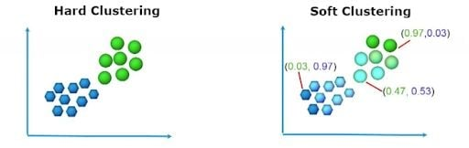
Step 2: Model Building
Fuzzy C-Means (FCM) Explanation:
FCM is a clustering method where each data point can belong to multiple clusters with different membership levels.
Need for Overlapping: Our data points shared characteristics across clusters.
However, it might make the interpretation of the clustering results more challenging, as the boundaries between clusters are not strictly defined.
(image from article)
Notes:
Here I will go a bit into detail about what FCM is and how it works.
To assign data points to clusters, normally it can follow 2 different approaches:
Hard partition and Fuzzy partition.
where hard partition strictly allocated data point to one cluster.
But fuzzy partition enables the cluster assignment for data point to belong to multiple clusters.
As shown here in this image, left one is the hard partition example and the right one is the fuzzy partition.
For example, you can see this data points has a possibility of cluster **GREEN** of 0.47 and possibility of cluster **BLUE** of 0.53.
The reason why FCM works well is because our data points share same characteristics across clusters.
This leaves a challenge for us, which needs more efforts for cluster verification since the boundaries between clusters are not strictly defined.
Morris will showcase this in later slides.

Slide 24
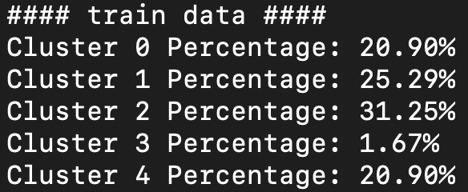
Step 2: Model Building
Hyperparameter tuning for FCM
Within cluster distance
Fit the best model with training data and the clustering result as shown below:
Notes:
With train split, using FCM, by performing required hyperparameter tuning to ensure the smallest within cluster distance.
We have the date points share the most similarities within clusters.
And the best model gave the above cluster percentages, most categories are pretty evenly distributed.
I will hand over to Morris for the next 2 steps.

Slide 25
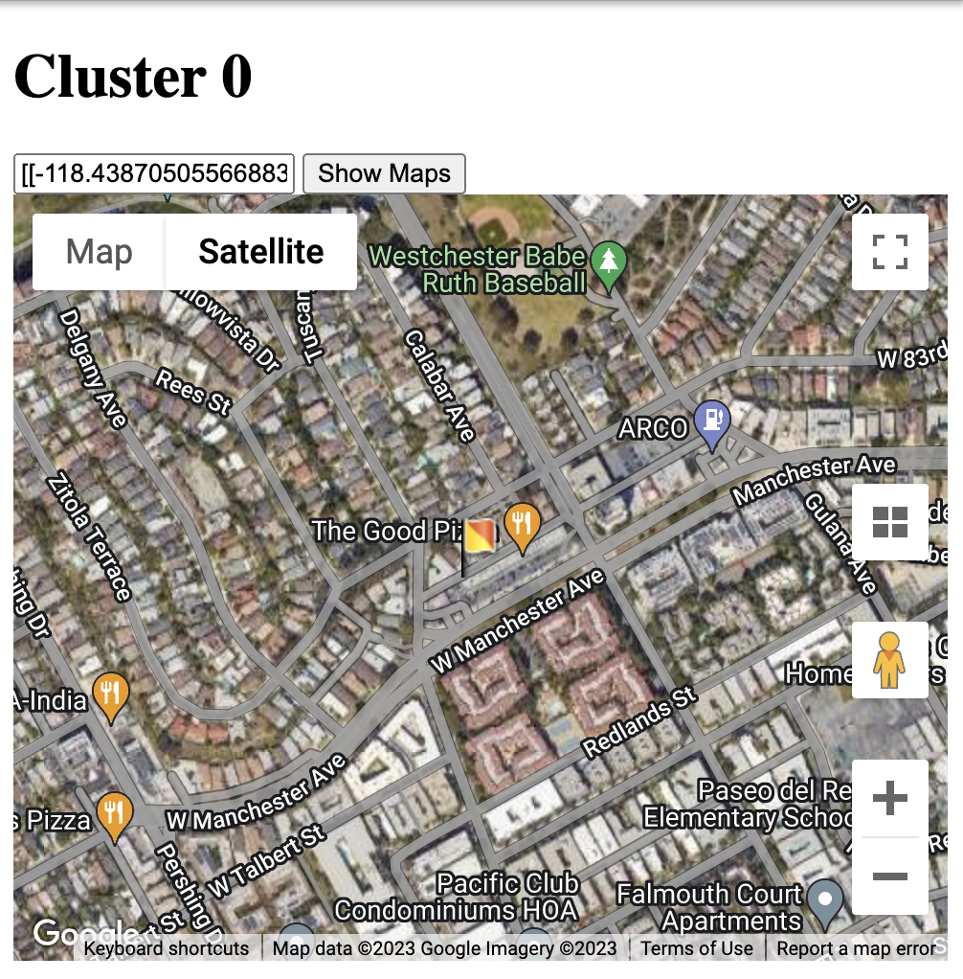
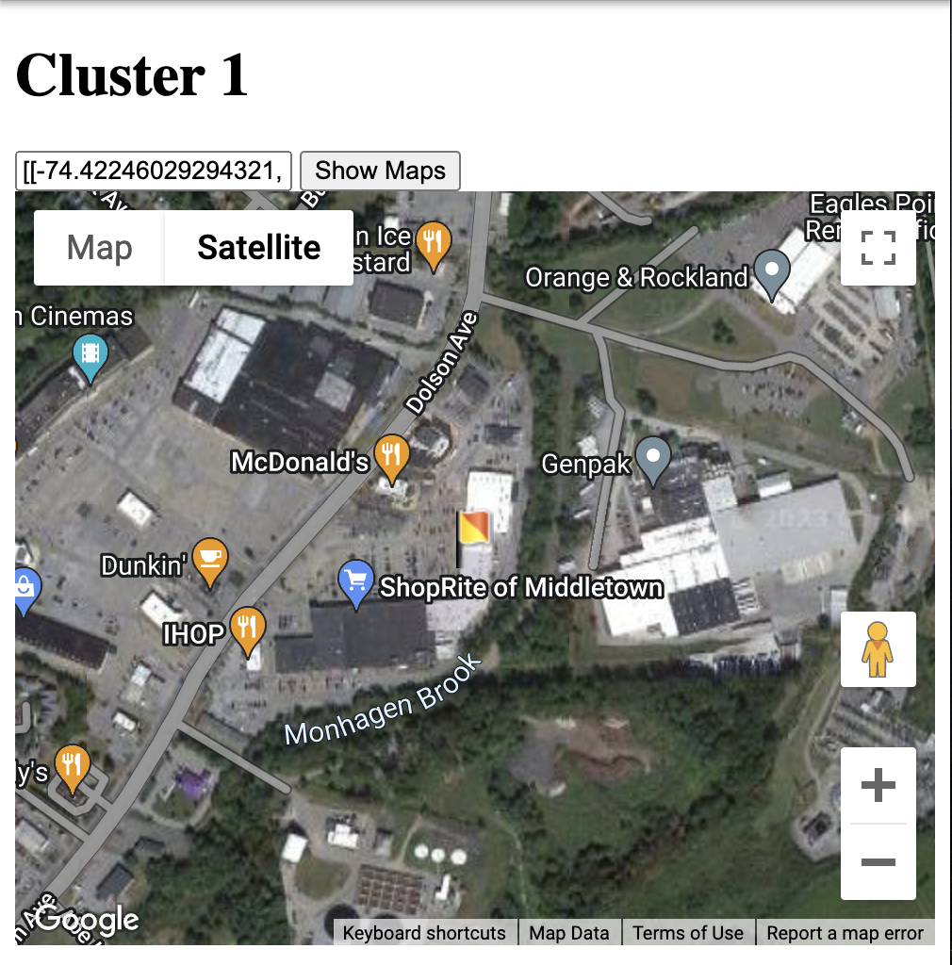
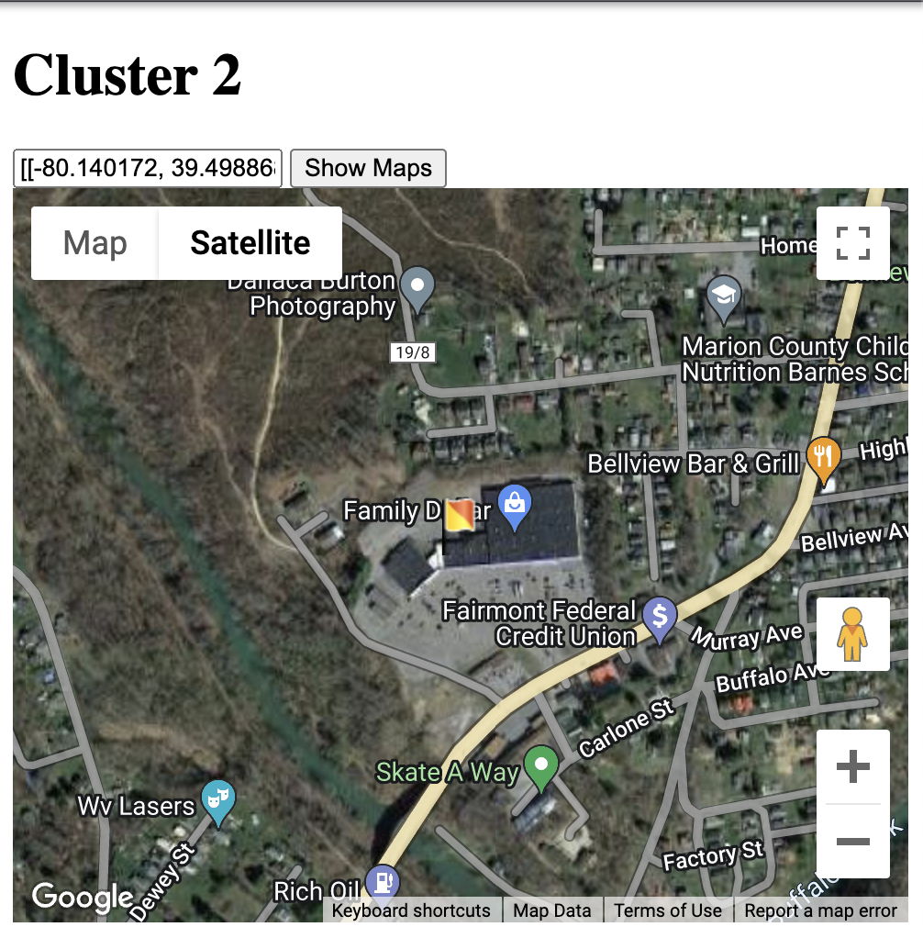
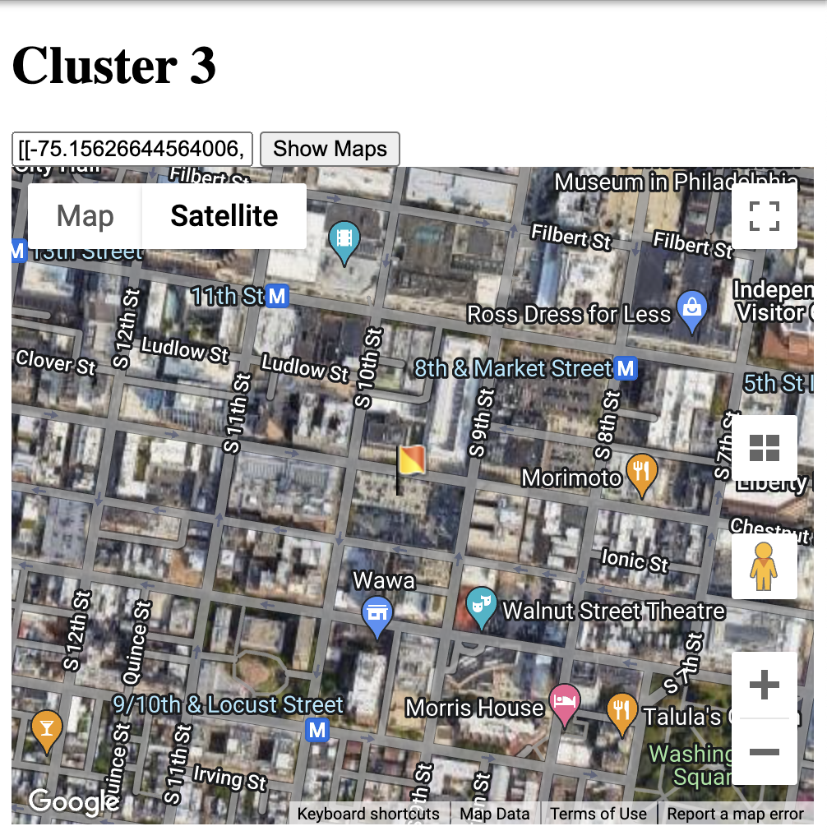
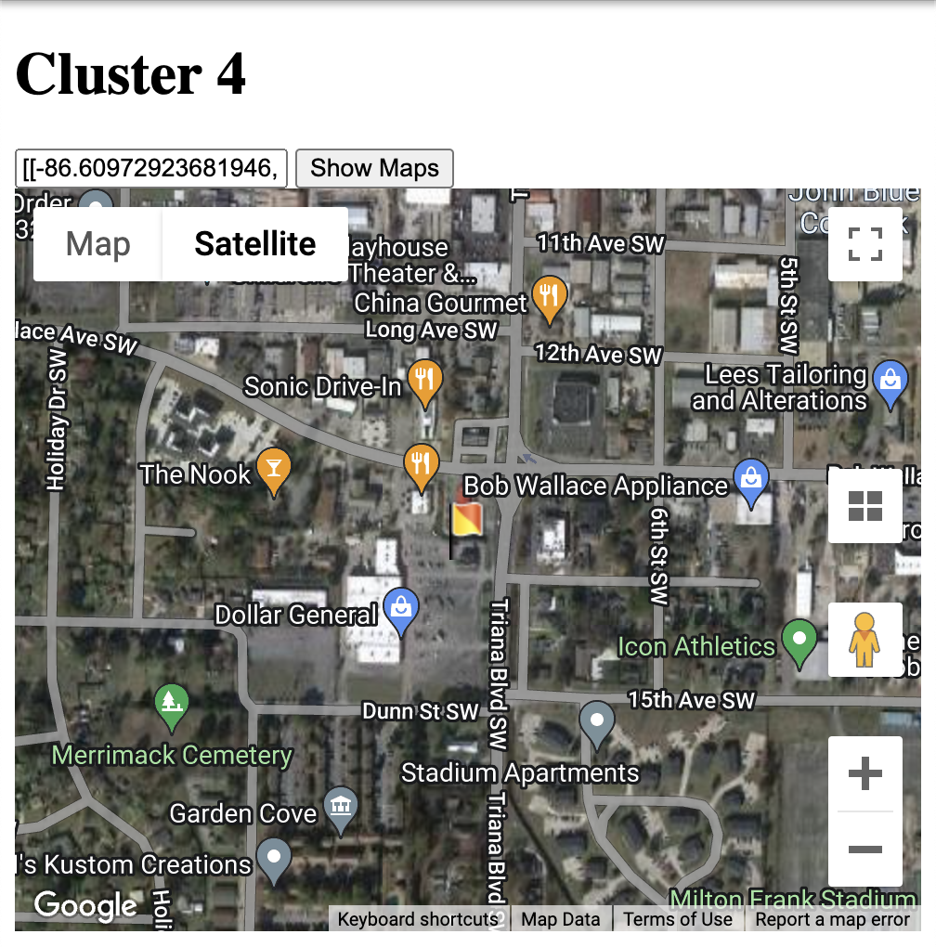
Step 3: Label Verification
Cluster 0: Home
Custer 1: Shopping
Custer 2: Rural and small town
Custer 3: Hyper urban (NYC, San Francisco, etc.)
Custer 4: Work
Notes:
Since we do not have label to verify our results. We came up with a verification method using Google Map.
Randomly select 30 stores from each cluster
Collect their longitude and latitude, then print them on Google Map
By checking their surroundings information we interpret the clusters as home, shopping, rural area, hyper urban, and work.

Slide 26
Step 3: Label Verification
Cluster 0: HOME
Notes:
As we look closer to the cluster 0, we can find that there are a lot of houses. So it may be the home categories.

Slide 27
Step 3: Label Verification
Cluster 1: SHOPPING
Notes:
For the cluster 1, we can find that there is a shopping area with a parking lot. So it may be the shopping categories.

Slide 28
Step 4: Cluster Interpretation
Using the labeled results from FCM, build a supervised model to predict the labels
RandomForestClassifier
Interpret feature importance using SHAP
Notes:
As we mentioned before, only look at the Google map is not enough.
After we use our unsupervised model to label our data.
We build a RandomForestClassifier, so we can have the feature importance using SHAP like the Smoothie King.

Slide 29
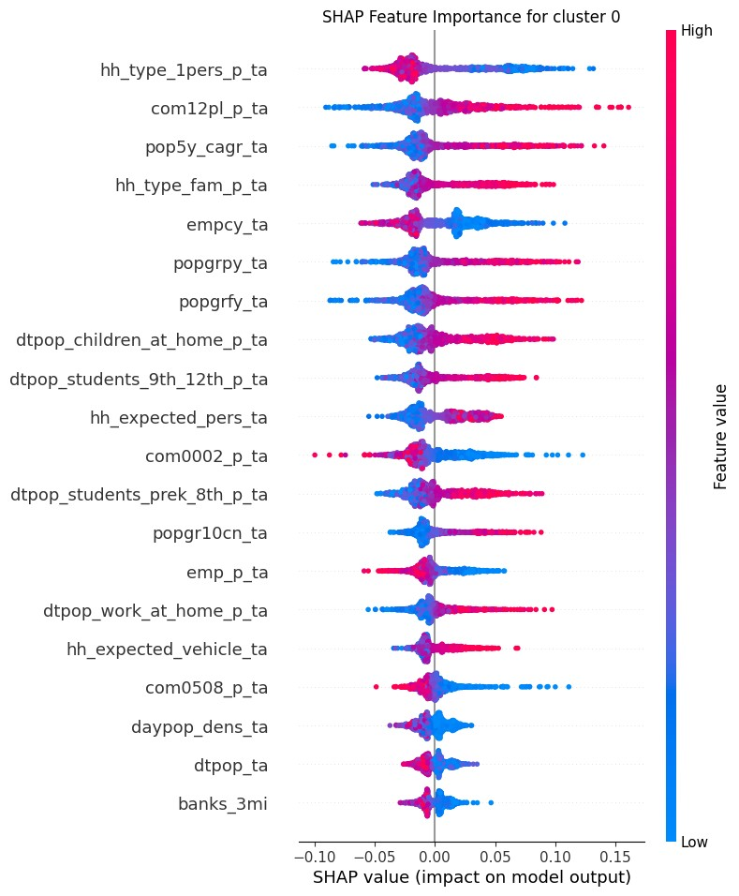
Cluster Interpretation
Cluster 0:
HOME
Key features:
% of family household type (hh_type_fam_p_ta)
% of employment (Emp_p_ta)
Proportion of daytime working at home population (dtpop_work_at_home_ta)
Notes:
As the SHAP plot shown
Higher the value of household type family and Daytime population work at home, higher the SHAP value
On the other hand, lower the value of employment percentage, higher the SHAP value
Those are important features for predicting HOME category
(ADD feature descriptions)

Slide 30
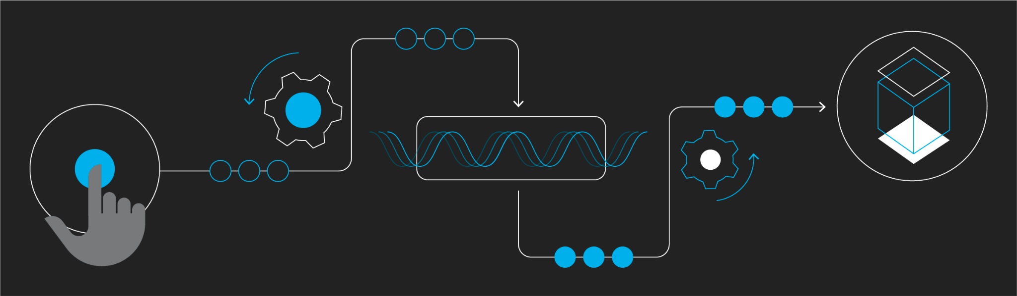
Data Product Pipeline
Notes:
We created a Make process for the partner to run and implement the entire workflow.

Slide 31
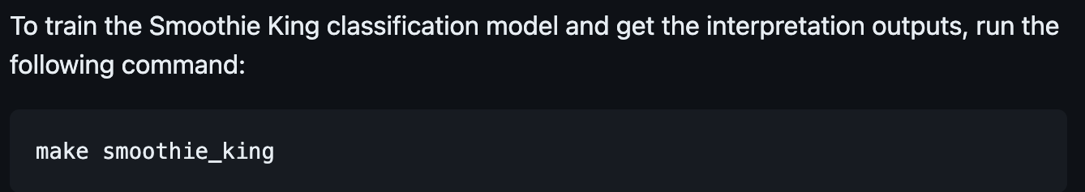
Data Product Pipeline - Smoothie King
Data Preprocessing
Model Building
Model Interpretation
Notes:
Step 1: Data preprocess
Step 2: Model building
Step 3: Generate SHAP plot images

Slide 32
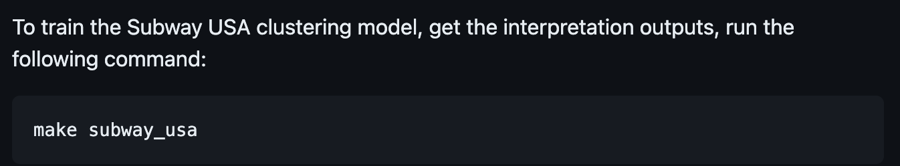
Data Product Pipeline - Subway USA
Data Preprocessing
Model Building
Cluster Verification
Label Interpretation
Notes:
Step 1: Data preprocess
Step 2: Model Building
Step 3: Label Verification
Step 4: Cluster Interpretation

Slide 33

Q&A

